Slide 1
Correlation
Chad Williams
University of Victoria

Slide 2
Lecture Outline
Bivariate Data
Computing Correlation
Factors that Influence r
Other Scales and Correlations

Slide 3
Lecture Outline
Bivariate Data
Computing Correlation
Factors that Influence r
Other Scales and Correlations

Slide 4
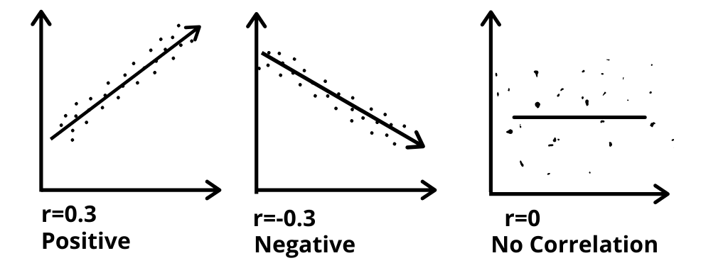
Bivariate Data
Involves two variables (X & Y)
Often two datapoints from the same thing (e.g., person)
But can be two things related by something (such as date)
Correlation: Method to describe the relationship between two variables
Varies from -1 to 1 (e.g., r = 0.30)
Regression: Predicting the values of one variable from another variable (Unit 2.2.)
Includes a slope and an intercept

Slide 5
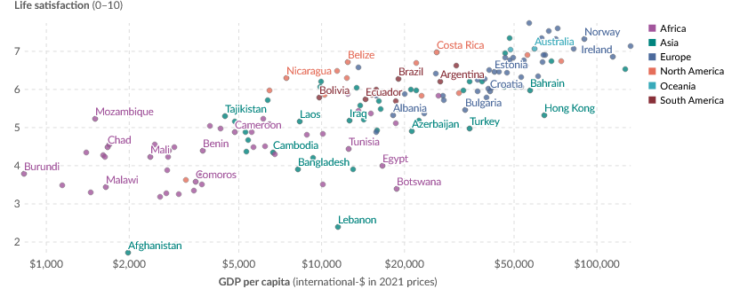

Slide 6
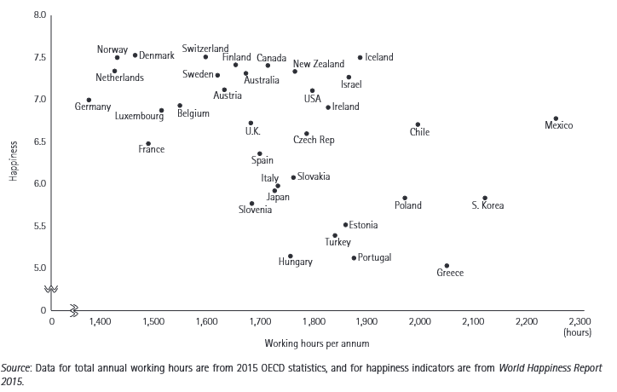

Slide 7
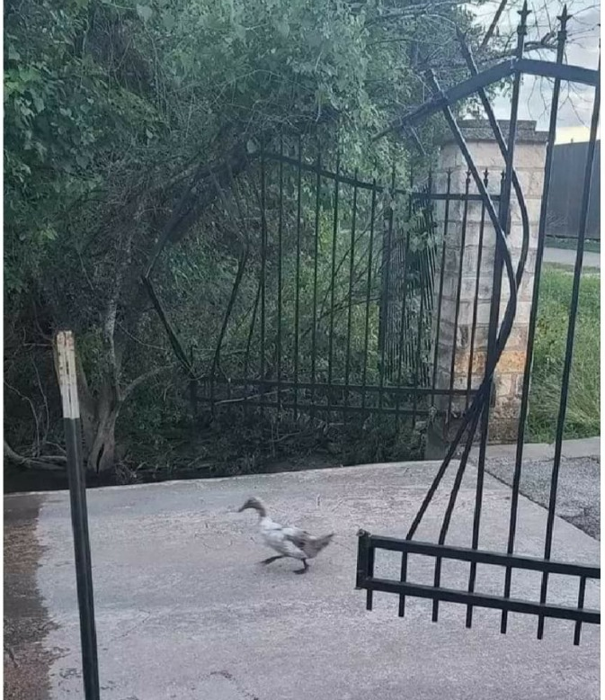
Correlation is not causation!

Slide 8

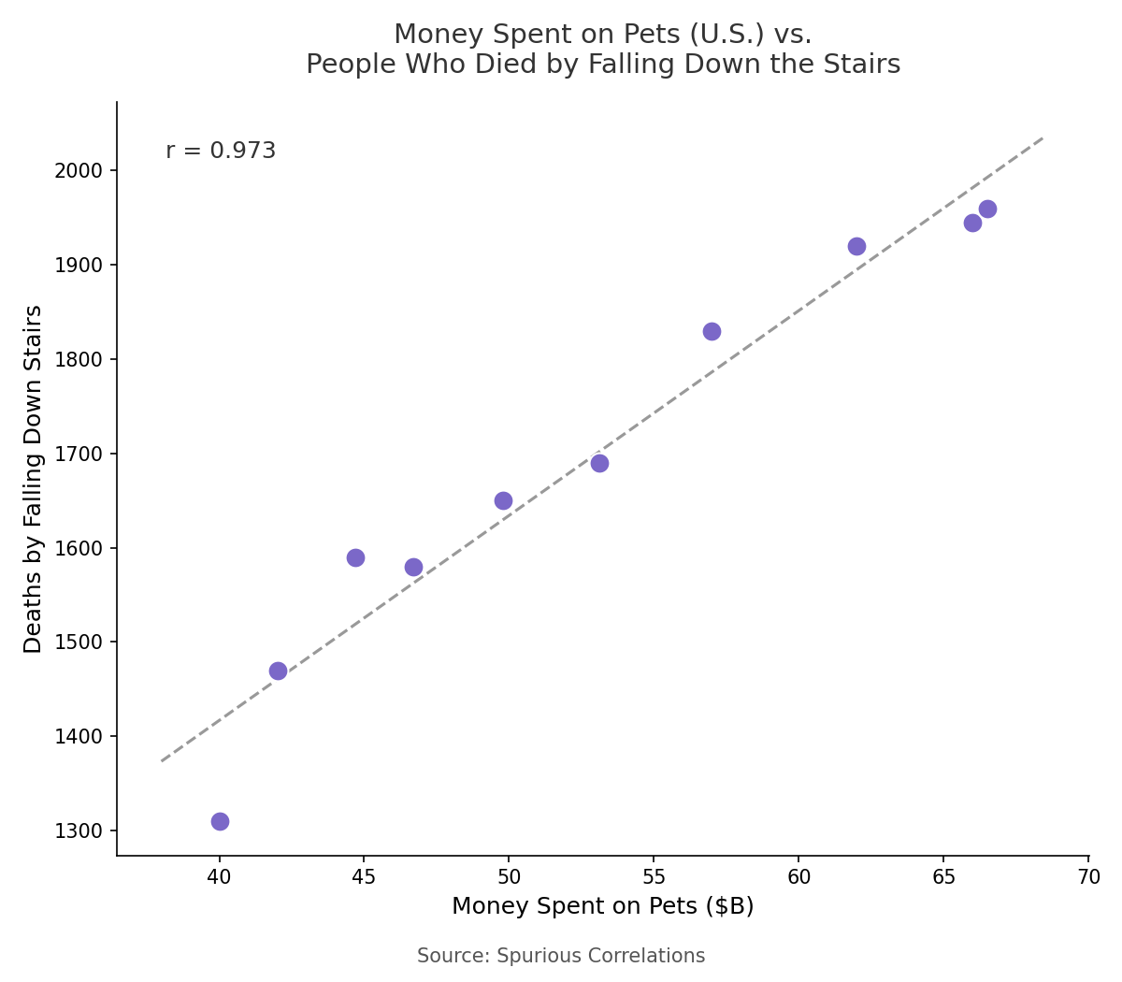
Correlation is not causation!

Slide 9

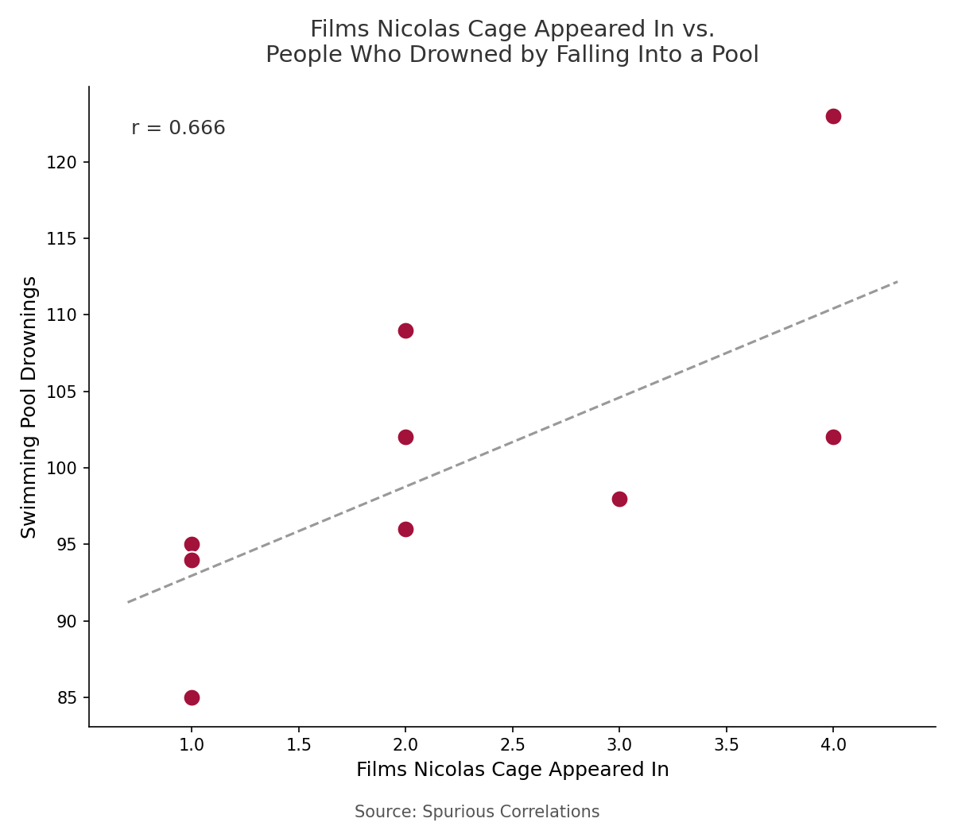
Correlation is not causation!

Slide 10
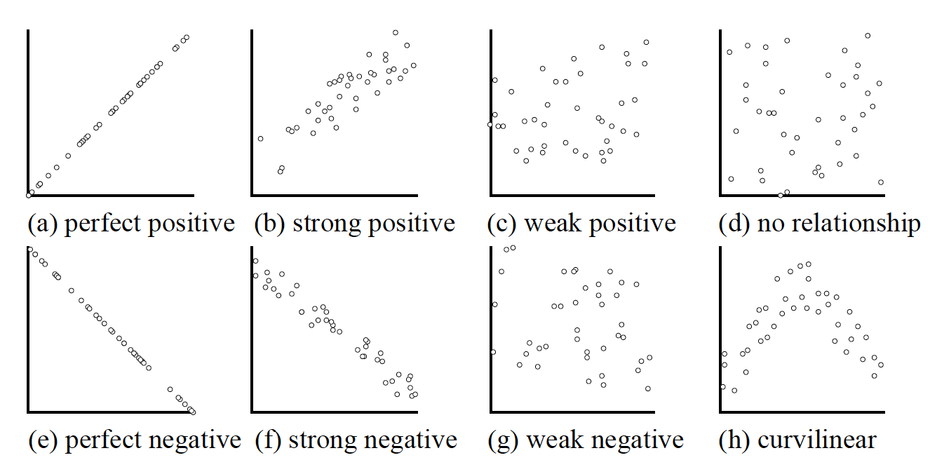
Visualizing Bivariate Data
Describing Relationships
From a Scatterplot:
Direction: Positive or negative
Strength: Weak, moderate, strong (subjective; based on visual)
Shape: Linear or curvilinear

Slide 11
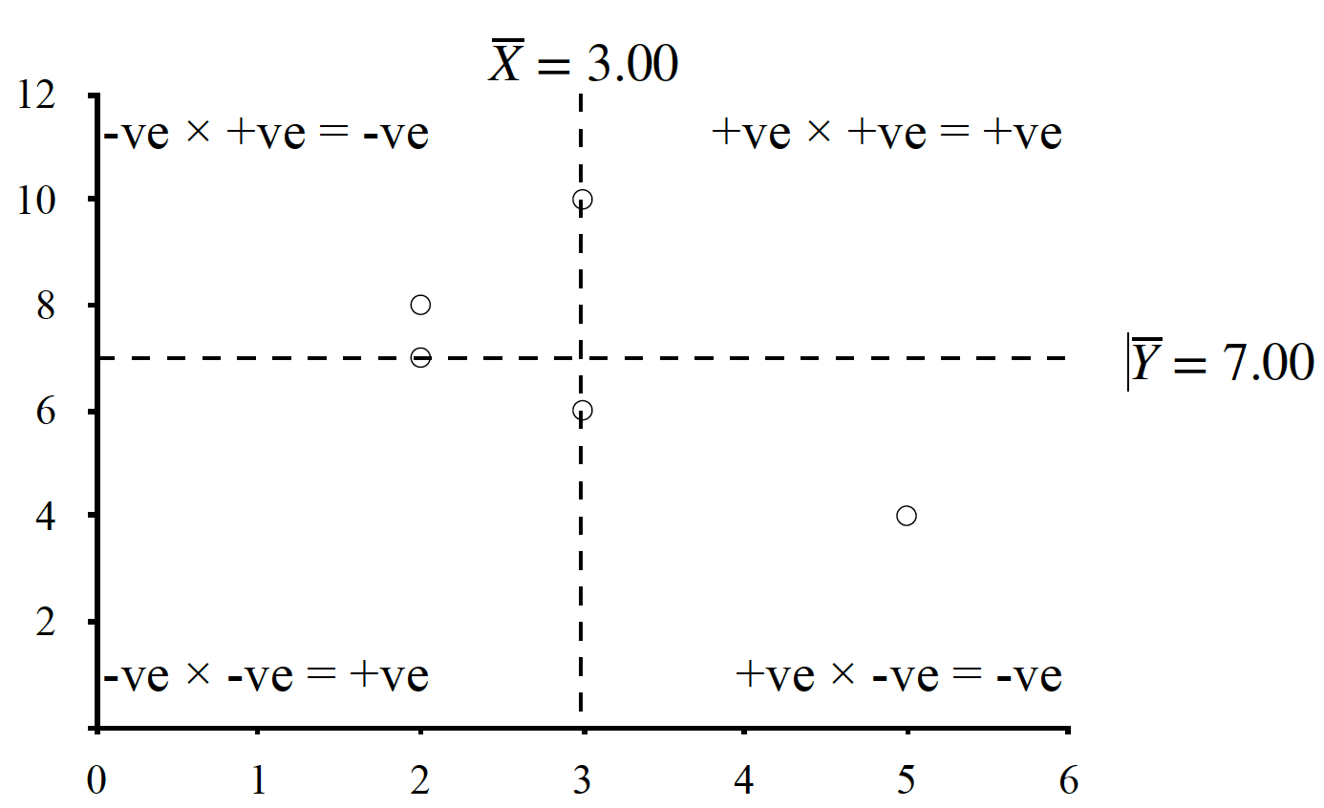
Visualizing Bivariate Data
Describing Relationships
From a Scatterplot:
Direction: Positive or negative
Negative Quadrant
Positive Quadrant
Positive Quadrant
Negative Quadrant

Slide 12
Visualizing Bivariate Data
Describing Relationships
From a Scatterplot:
Direction: Positive or negative
Strength: Weak, moderate, strong (subjective; based on visual)

Slide 13
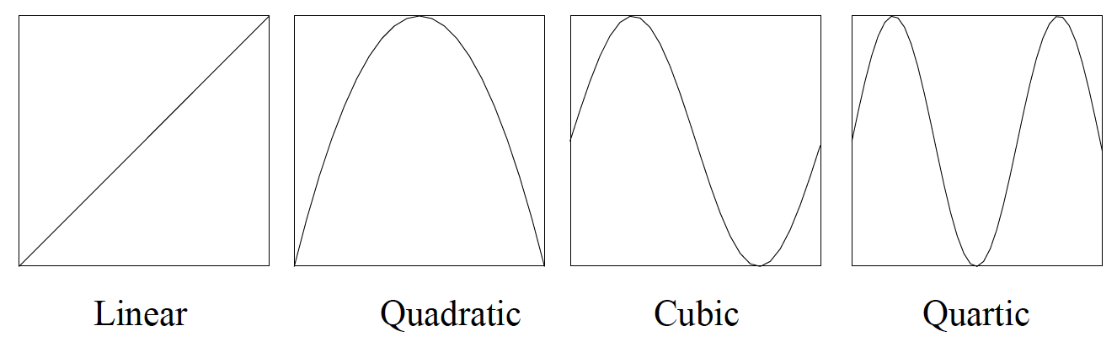
Visualizing Bivariate Data
Describing Relationships
From a Scatterplot:
Direction: Positive or negative
Strength: Weak, moderate, strong (subjective; based on visual)
Shape: Linear or curvilinear
A linear description of a curvilinear relationship underestimates real rel.
Always important to plot data!

Slide 14
Visualizing Bivariate Data
Describing Relationships

Slide 15
Measuring Bivariate Data
Describing Relationships
From a Correlation Coefficient:
Direction: Positive or negative
Magnitude: Size (objective)
Strength: Weak, moderate, strong (subjective; based on visual)
Shape: Linear or curvilinear

Slide 16
Lecture Outline
Bivariate Data
Computing Correlation
Factors that Influence r
Other Scales and Correlations

Slide 17
Computing Correlation
Steps for Dealing with Bivariate Data
Plot Data
Apply descriptive statistics (mean, SD) to each variable
Apply descriptive statistics to the joint variables
Compute correlation coefficient

Slide 18





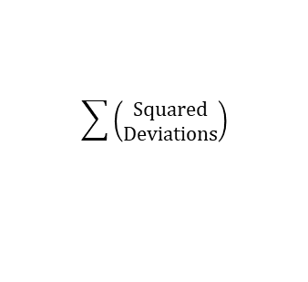
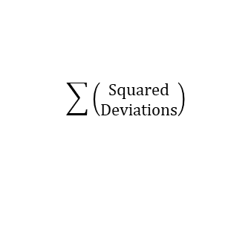



$$x − \bar{x}$$
$${deviations}^{2}$$
$$\sum{\left(\begin{aligned}Squared \\ Deviations\end{aligned}\right)}$$
$$\frac{SS}{n}$$
$$\sqrt{{SD}^{2}}$$
X
Deviations
Squared
Deviations
Sum of Squares
(SS)
Variance
(SD²)
Standard Deviation
(SDₓ)
$$y − \bar{y}$$
$${deviations}^{2}$$
$$\sum{\left(\begin{aligned}Squared \\ Deviations\end{aligned}\right)}$$
$$\frac{SS}{n}$$
$$\sqrt{{SD}^{2}}$$
Y
Deviations
Squared
Deviations
Sum of Squares
(SS)
Variance
(SD²)
Standard Deviation
(SDᵧ)

Slide 19

$$x − \bar{x}$$
$${deviations}^{2}$$
$$\sum{\left(\begin{aligned}Squared \\ Deviations\end{aligned}\right)}$$
$$\frac{SS}{n}$$
$$\sqrt{{SD}^{2}}$$
X
Deviations
Squared
Deviations
Sum of Squares
(SS)
Variance
(SD²)
Standard Deviation
(SDₓ)
$$\left(x − \bar{x}\right)\left(y − \bar{y}\right)$$
Product of
Deviations
$$y − \bar{y}$$
$${deviations}^{2}$$
$$\sum{\left(\begin{aligned}Squared \\ Deviations\end{aligned}\right)}$$
$$\frac{SS}{n}$$
$$\sqrt{{SD}^{2}}$$
Y
Deviations
Squared
Deviations
Sum of Squares
(SS)
Variance
(SD²)
Standard Deviation
(SDᵧ)

Slide 20
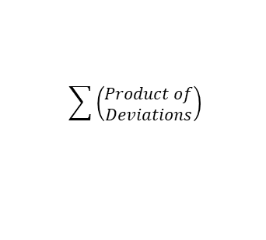
$$x − \bar{x}$$
$${deviations}^{2}$$
$$\sum{\left(\begin{aligned}Squared \\ Deviations\end{aligned}\right)}$$
$$\frac{SS}{n}$$
$$\sqrt{{SD}^{2}}$$
X
Deviations
Squared
Deviations
Sum of Squares
(SS)
Variance
(SD²)
Standard Deviation
(SDₓ)
$$\sum{\left(\begin{aligned}Product of \\ Deviations\end{aligned}\right)}$$
$$\left(x − \bar{x}\right)\left(y − \bar{y}\right)$$
Product of
Deviations
Sum of Products
(SP)
$$y − \bar{y}$$
$${deviations}^{2}$$
$$\sum{\left(\begin{aligned}Squared \\ Deviations\end{aligned}\right)}$$
$$\frac{SS}{n}$$
$$\sqrt{{SD}^{2}}$$
Y
Deviations
Squared
Deviations
Sum of Squares
(SS)
Variance
(SD²)
Standard Deviation
(SDᵧ)

Slide 21

$$x − \bar{x}$$
$${deviations}^{2}$$
$$\sum{\left(\begin{aligned}Squared \\ Deviations\end{aligned}\right)}$$
$$\frac{SS}{n}$$
$$\sqrt{{SD}^{2}}$$
X
Deviations
Squared
Deviations
Sum of Squares
(SS)
Variance
(SD²)
Standard Deviation
(SDₓ)
$$\sum{\left(\begin{aligned}Product of \\ Deviations\end{aligned}\right)}$$
$$\frac{SP}{n}$$
$$\left(x − \bar{x}\right)\left(y − \bar{y}\right)$$
Product of
Deviations
Sum of Products
(SP)
Covariance
(COV)
$$y − \bar{y}$$
$${deviations}^{2}$$
$$\sum{\left(\begin{aligned}Squared \\ Deviations\end{aligned}\right)}$$
$$\frac{SS}{n}$$
$$\sqrt{{SD}^{2}}$$
Y
Deviations
Squared
Deviations
Sum of Squares
(SS)
Variance
(SD²)
Standard Deviation
(SDᵧ)

Slide 22
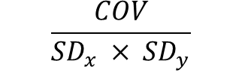
$$x − \bar{x}$$
$${deviations}^{2}$$
$$\sum{\left(\begin{aligned}Squared \\ Deviations\end{aligned}\right)}$$
$$\frac{SS}{n}$$
$$\sqrt{{SD}^{2}}$$
X
Deviations
Squared
Deviations
Sum of Squares
(SS)
Variance
(SD²)
Standard Deviation
(SDₓ)
$$\sum{\left(\begin{aligned}Product of \\ Deviations\end{aligned}\right)}$$
$$\frac{SP}{n}$$
$$\frac{COV}{{SD}_{x} × {SD}_{y}}$$
$$\left(x − \bar{x}\right)\left(y − \bar{y}\right)$$
Product of
Deviations
Sum of Products
(SP)
Covariance
(COV)
Correlation
(r)
$$y − \bar{y}$$
$${deviations}^{2}$$
$$\sum{\left(\begin{aligned}Squared \\ Deviations\end{aligned}\right)}$$
$$\frac{SS}{n}$$
$$\sqrt{{SD}^{2}}$$
Y
Deviations
Squared
Deviations
Sum of Squares
(SS)
Variance
(SD²)
Standard Deviation
(SDᵧ)

Slide 23
$$x − \bar{x}$$
$${deviations}^{2}$$
$$\sum{\left(\begin{aligned}Squared \\ Deviations\end{aligned}\right)}$$
$$\frac{SS}{n}$$
$$\sqrt{{SD}^{2}}$$
X
Deviations
Squared
Deviations
Sum of Squares
(SS)
Variance
(SD²)
Standard Deviation
(SDₓ)
$$\sum{\left(\begin{aligned}Product of \\ Deviations\end{aligned}\right)}$$
$$\frac{SP}{n}$$
$$\frac{COV}{{SD}_{x} × {SD}_{y}}$$
$$\left(x − \bar{x}\right)\left(y − \bar{y}\right)$$
Product of
Deviations
Sum of Products
(SP)
Covariance
(COV)
Correlation
(r)
$$y − \bar{y}$$
$${deviations}^{2}$$
$$\sum{\left(\begin{aligned}Squared \\ Deviations\end{aligned}\right)}$$
$$\frac{SS}{n}$$
$$\sqrt{{SD}^{2}}$$
Y
Deviations
Squared
Deviations
Sum of Squares
(SS)
Variance
(SD²)
Standard Deviation
(SDᵧ)

Slide 24
Computing Correlation
Example
Person | X (Run Time) | Y (Shoe Size)
A | 3 | 10
B | 5 | 4
C | 2 | 8
D | 2 | 7
E | 3 | 6

Slide 25
Computing Correlation
Steps for Dealing with Bivariate Data
Plot Data
Apply descriptive statistics (mean, SD) to each variable
Apply descriptive statistics to the joint variables
Compute correlation coefficient

Slide 26
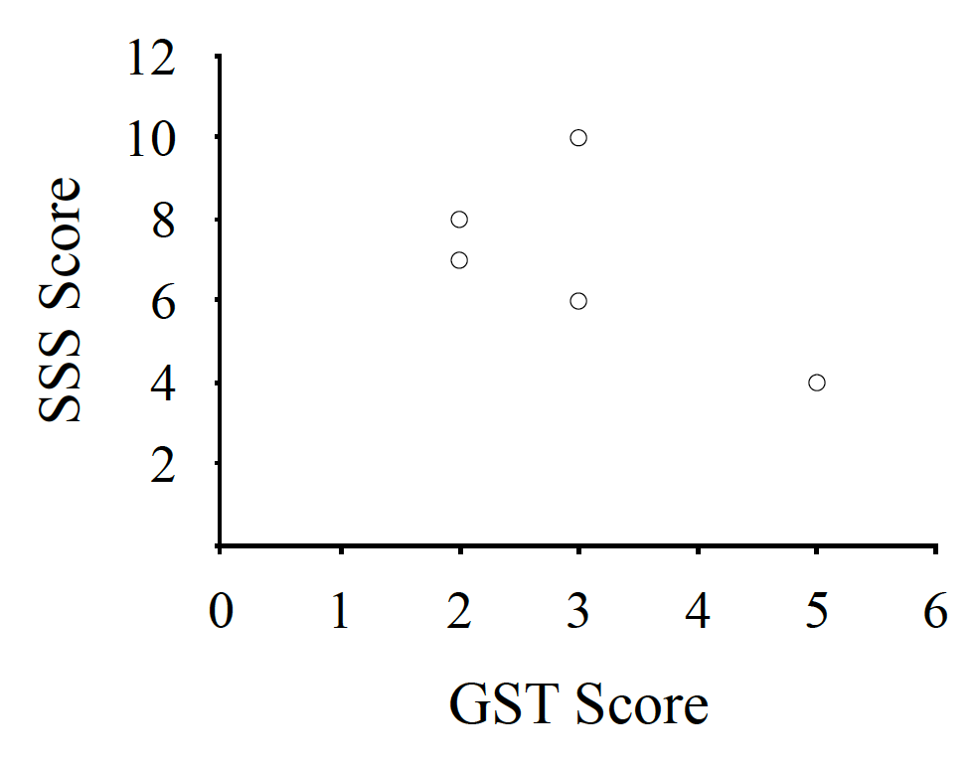
Computing Correlation
Example
Person | X (Run Time) | Y (Shoe Size)
A | 3 | 10
B | 5 | 4
C | 2 | 8
D | 2 | 7
E | 3 | 6
Shoe Size
1KM Run Time (Mins)

Slide 27
Computing Correlation
Steps for Dealing with Bivariate Data
Plot Data
Apply descriptive statistics (mean, SD) to each variable
Apply descriptive statistics to the joint variables
Compute correlation coefficient

Slide 28
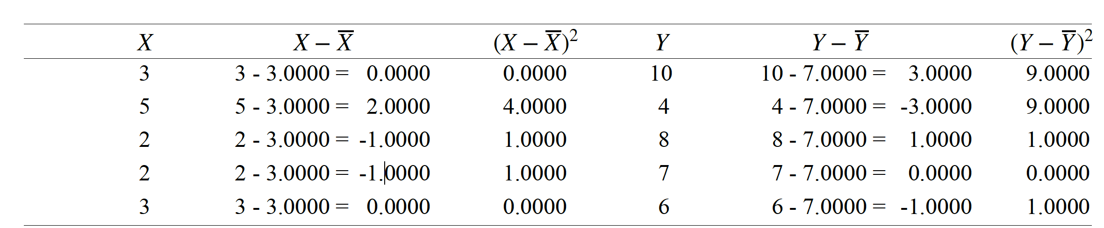
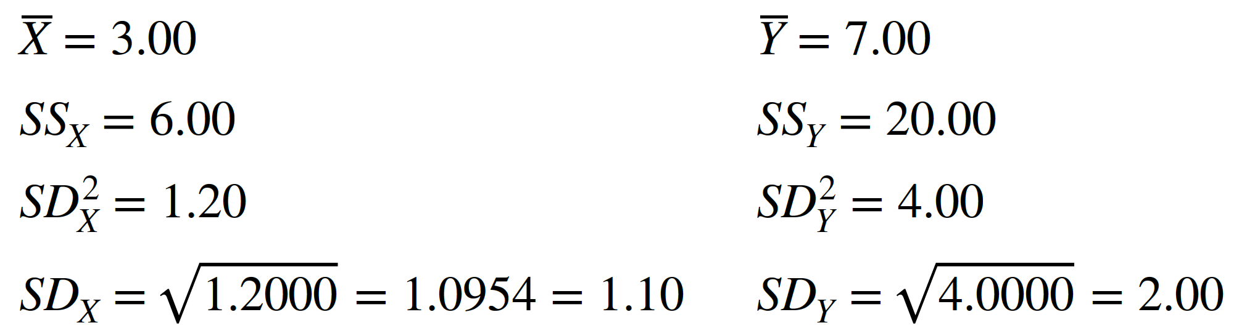
Computing X and Y Descriptives
Example

Slide 29
Computing X and Y Descriptives
Example

Slide 30
Computing Correlation
Steps for Dealing with Bivariate Data
Plot Data
Apply descriptive statistics (mean, SD) to each variable
Apply descriptive statistics to the joint variables
Compute correlation coefficient

Slide 31
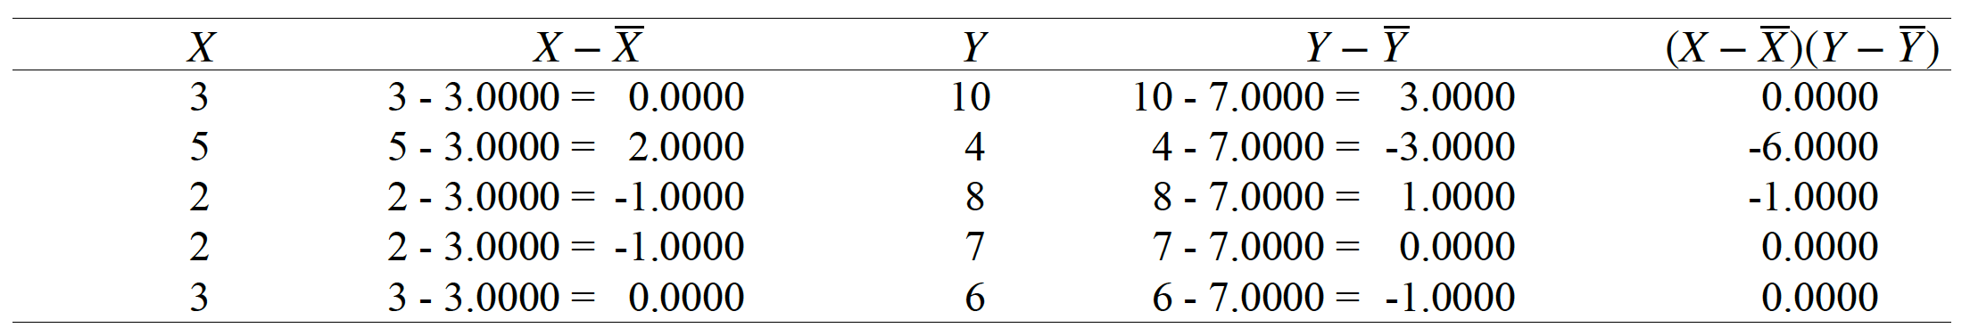
Computing Joint XY Descriptives
Product of
Deviations
Example
Sums of Products (SP): ∑((x-x̅)(y-y̅))
= -7.0000 (report: -7.00)
Like sums of squares, but for the products
Describes how each score deviated from each mean

Slide 32

Computing Joint XY Descriptives
Example
Covariance (Cov): $\frac{SP}{N}$
$\frac{−7.0000}{5} = 1.4000 (report: −1.40)$
Like variance, but for the products
Measure of covariability
Not in any meaningful units (products of units)

Slide 33
Computing Correlation
Steps for Dealing with Bivariate Data
Plot Data
Apply descriptive statistics (mean, SD) to each variable
Apply descriptive statistics to the joint variables
Compute correlation coefficient

Slide 34


Pearson r
Pearson r: Degree to which two variables covary
Standardized measure of correlation
r = $\frac{Cov}{SDxSDy}$
r = $\frac{Cov}{SDxSDy}$ = $\frac{−1.4000}{1.0954∗2.0000}$ = -0.6390 = -.64
Sums of Product (SP): ∑((X-X̄)(Y-Ȳ)) = -7.00
Covariance (Cov): $\frac{SP}{N}=\frac{−7.0000}{5}=−1.40$

Slide 35
$$x − \bar{x}$$
$${deviations}^{2}$$
$$\sum{\left(\begin{aligned}Squared \\ Deviations\end{aligned}\right)}$$
$$\frac{SS}{n}$$
$$\sqrt{{SD}^{2}}$$
X
Deviations
Squared
Deviations
Sum of Squares
(SS)
Variance
(SD²)
Standard Deviation
(SDₓ)
$$y − \bar{y}$$
$${deviations}^{2}$$
$$\sum{\left(\begin{aligned}Squared \\ Deviations\end{aligned}\right)}$$
$$\frac{SS}{n}$$
$$\sqrt{{SD}^{2}}$$
Y
Deviations
Squared
Deviations
Sum of Squares
(SS)
Variance
(SD²)
Standard Deviation
(SDᵧ)

Slide 36
$$x − \bar{x}$$
$${deviations}^{2}$$
$$\sum{\left(\begin{aligned}Squared \\ Deviations\end{aligned}\right)}$$
$$\frac{SS}{n}$$
$$\sqrt{{SD}^{2}}$$
X
Deviations
Squared
Deviations
Sum of Squares
(SS)
Variance
(SD²)
Standard Deviation
(SDₓ)
$$\left(x − \bar{x}\right)\left(y − \bar{y}\right)$$
Product of
Deviations
$$y − \bar{y}$$
$${deviations}^{2}$$
$$\sum{\left(\begin{aligned}Squared \\ Deviations\end{aligned}\right)}$$
$$\frac{SS}{n}$$
$$\sqrt{{SD}^{2}}$$
Y
Deviations
Squared
Deviations
Sum of Squares
(SS)
Variance
(SD²)
Standard Deviation
(SDᵧ)

Slide 37
$$x − \bar{x}$$
$${deviations}^{2}$$
$$\sum{\left(\begin{aligned}Squared \\ Deviations\end{aligned}\right)}$$
$$\frac{SS}{n}$$
$$\sqrt{{SD}^{2}}$$
X
Deviations
Squared
Deviations
Sum of Squares
(SS)
Variance
(SD²)
Standard Deviation
(SDₓ)
$$\sum{\left(\begin{aligned}Product of \\ Deviations\end{aligned}\right)}$$
$$\left(x − \bar{x}\right)\left(y − \bar{y}\right)$$
Product of
Deviations
Sum of Products
(SP)
$$y − \bar{y}$$
$${deviations}^{2}$$
$$\sum{\left(\begin{aligned}Squared \\ Deviations\end{aligned}\right)}$$
$$\frac{SS}{n}$$
$$\sqrt{{SD}^{2}}$$
Y
Deviations
Squared
Deviations
Sum of Squares
(SS)
Variance
(SD²)
Standard Deviation
(SDᵧ)

Slide 38
$$x − \bar{x}$$
$${deviations}^{2}$$
$$\sum{\left(\begin{aligned}Squared \\ Deviations\end{aligned}\right)}$$
$$\frac{SS}{n}$$
$$\sqrt{{SD}^{2}}$$
X
Deviations
Squared
Deviations
Sum of Squares
(SS)
Variance
(SD²)
Standard Deviation
(SDₓ)
$$\sum{\left(\begin{aligned}Product of \\ Deviations\end{aligned}\right)}$$
$$\frac{SP}{n}$$
$$\left(x − \bar{x}\right)\left(y − \bar{y}\right)$$
Product of
Deviations
Sum of Products
(SP)
Covariance
(COV)
$$y − \bar{y}$$
$${deviations}^{2}$$
$$\sum{\left(\begin{aligned}Squared \\ Deviations\end{aligned}\right)}$$
$$\frac{SS}{n}$$
$$\sqrt{{SD}^{2}}$$
Y
Deviations
Squared
Deviations
Sum of Squares
(SS)
Variance
(SD²)
Standard Deviation
(SDᵧ)

Slide 39
$$x − \bar{x}$$
$${deviations}^{2}$$
$$\sum{\left(\begin{aligned}Squared \\ Deviations\end{aligned}\right)}$$
$$\frac{SS}{n}$$
$$\sqrt{{SD}^{2}}$$
X
Deviations
Squared
Deviations
Sum of Squares
(SS)
Variance
(SD²)
Standard Deviation
(SDₓ)
$$\sum{\left(\begin{aligned}Product of \\ Deviations\end{aligned}\right)}$$
$$\frac{SP}{n}$$
$$\frac{COV}{{SD}_{x} × {SD}_{y}}$$
$$\left(x − \bar{x}\right)\left(y − \bar{y}\right)$$
Product of
Deviations
Sum of Products
(SP)
Covariance
(COV)
Correlation
(r)
$$y − \bar{y}$$
$${deviations}^{2}$$
$$\sum{\left(\begin{aligned}Squared \\ Deviations\end{aligned}\right)}$$
$$\frac{SS}{n}$$
$$\sqrt{{SD}^{2}}$$
Y
Deviations
Squared
Deviations
Sum of Squares
(SS)
Variance
(SD²)
Standard Deviation
(SDᵧ)

Slide 40
$$x − \bar{x}$$
$${deviations}^{2}$$
$$\sum{\left(\begin{aligned}Squared \\ Deviations\end{aligned}\right)}$$
$$\frac{SS}{n}$$
$$\sqrt{{SD}^{2}}$$
X
Deviations
Squared
Deviations
Sum of Squares
(SS)
Variance
(SD²)
Standard Deviation
(SDₓ)
$$\sum{\left(\begin{aligned}Product of \\ Deviations\end{aligned}\right)}$$
$$\frac{SP}{n}$$
$$\frac{COV}{{SD}_{x} × {SD}_{y}}$$
$$\left(x − \bar{x}\right)\left(y − \bar{y}\right)$$
Product of
Deviations
Sum of Products
(SP)
Covariance
(COV)
Correlation
(r)
$$y − \bar{y}$$
$${deviations}^{2}$$
$$\sum{\left(\begin{aligned}Squared \\ Deviations\end{aligned}\right)}$$
$$\frac{SS}{n}$$
$$\sqrt{{SD}^{2}}$$
Y
Deviations
Squared
Deviations
Sum of Squares
(SS)
Variance
(SD²)
Standard Deviation
(SDᵧ)

Slide 41
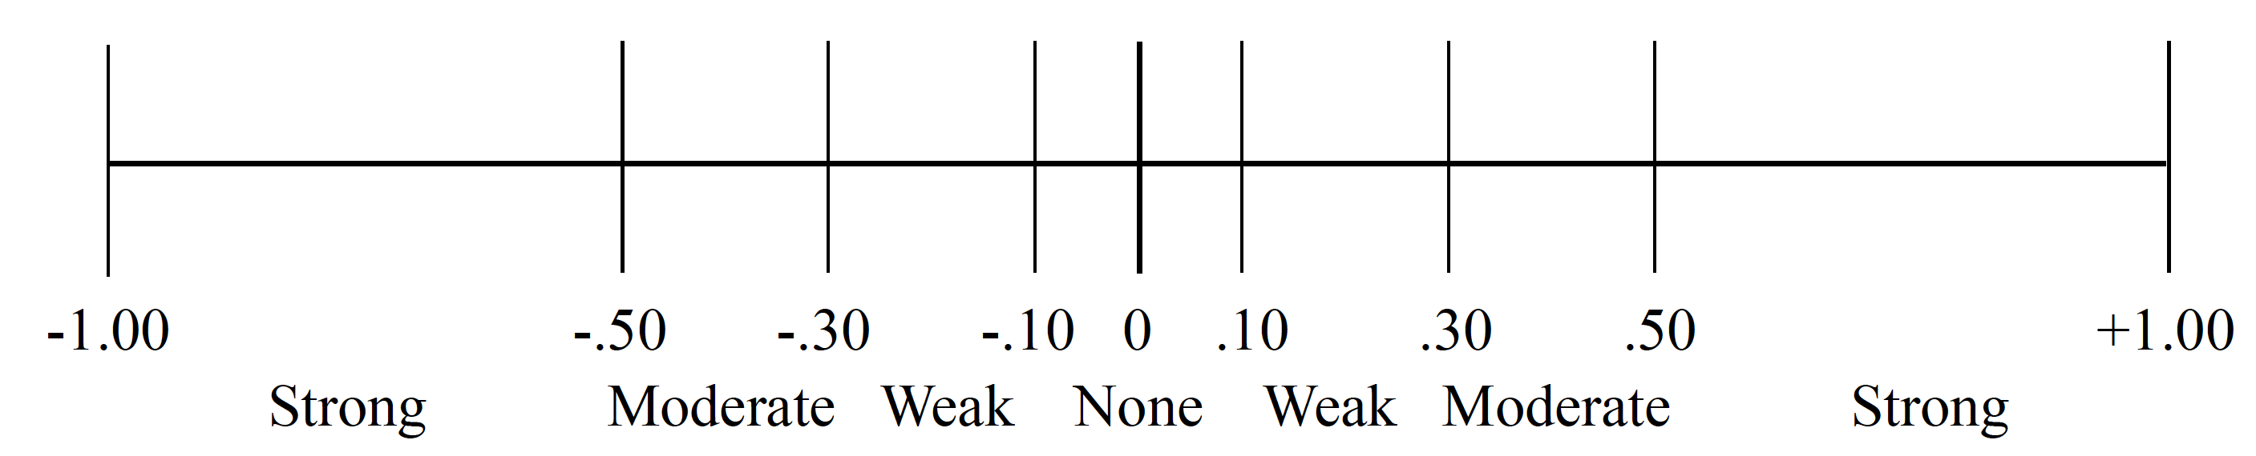
Measuring Bivariate Data
Describing Relationships
From a Correlation Coefficient:
Direction: Positive or negative
Magnitude: Size (r = -.64)
Strength: Weak, moderate, strong (based on r value)
Shape: Linear or curvilinear

Slide 42
Formal Report
For our five participants, there was a strong, negative, linear relationship, r = -.64, between participant shoe size (Ȳ = 7.00, SD = 2.00) and 1km run time (x̅ = 3.00, SD = 1.10). As shoe size increased, run time decreased.

Slide 43
Lecture Outline
Bivariate Data
Computing Correlation
Factors that Influence r
Other Scales and Correlations

Slide 44
Factors that Influence Pearson r
Relationship is real and strong/weak
Sampling error
Unmeasured third variable
Heterogenous sample
Truncated ranges
Non-Linear Relationship
Heteroscedasticity

Slide 45
Factors that Influence Pearson r
Relationship is real and strong/weak
Sampling error
Unmeasured third variable
Heterogenous sample
Truncated ranges
Non-Linear Relationship
Heteroscedasticity

Slide 46
Factors that Influence Pearson r
Of course, our correlation depends on how strong the real (population) relationship is

Slide 47
Factors that Influence Pearson r
Relationship is real and strong/weak
Sampling error
Unmeasured third variable
Heterogenous sample
Truncated ranges
Non-Linear Relationship
Heteroscedasticity

Slide 48
Factors that Influence Pearson r
Sampling Error: Discrepancy between sample statistics and population parameter
Each sample had inherent variability from the population
Central tendency and variability then may differ across samples
Each sample may increase or decrease r by chance

Slide 49
Factors that Influence Pearson r
Relationship is real and strong/weak
Sampling error
Unmeasured third variable
Heterogenous sample
Truncated ranges
Non-Linear Relationship
Heteroscedasticity

Slide 50
Factors that Influence Pearson r
Unmeasured Third Variable:
Two things can be related because of some other factor that we didn’t track in our study
E.g., crime is correlated with ice cream sales because both increase with better weather
Mediation and moderation tests can be used to test for third variable influences (these are not covered in this course)

Slide 51
Factors that Influence Pearson r
Relationship is real and strong/weak
Sampling error
Unmeasured third variable
Heterogenous sample
Truncated ranges
Non-Linear Relationship
Heteroscedasticity

Slide 52
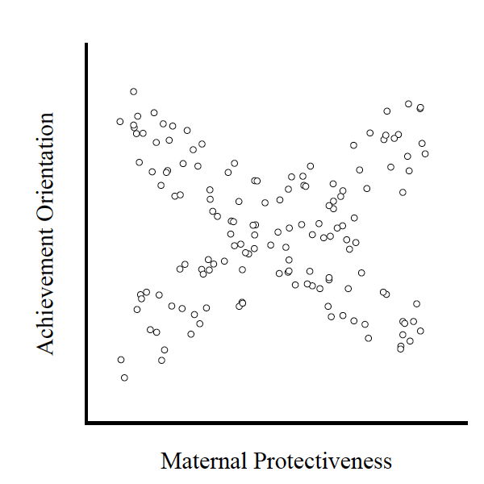
Factors that Influence Pearson r
r = -.03
r = -.93
r = .92
Heterogenous Sample: When your sample includes multiple sub-samples
Can decrease r if sub-samples behave differently

Slide 53
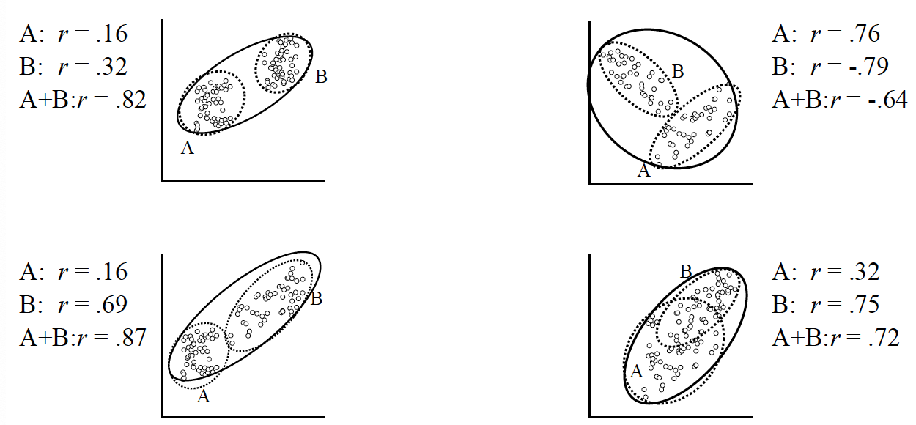
Factors that Influence Pearson r
Heterogenous Sample: When your sample includes multiple sub-samples
Can decrease r if sub-samples behave differently
Can increase r by chance if subsamples line up into a correlation

Slide 54
Factors that Influence Pearson r
Relationship is real and strong/weak
Sampling error
Unmeasured third variable
Heterogenous sample
Truncated ranges
Non-Linear Relationship
Heteroscedasticity

Slide 55
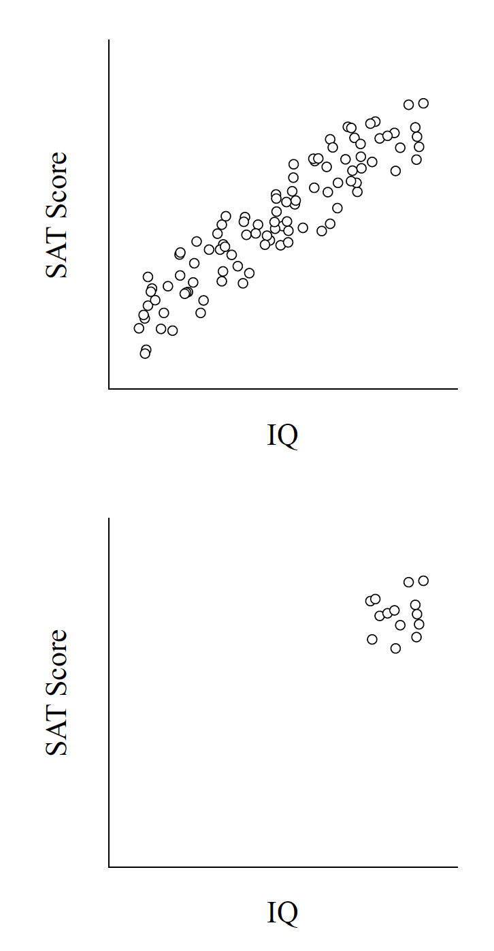
Factors that Influence Pearson r
Truncated Range: When data are collected from a restricted range of the full scale, the resulting scores may provide incomplete or misleading information about the true relationship across the entire range
Most often reduces r

Slide 56
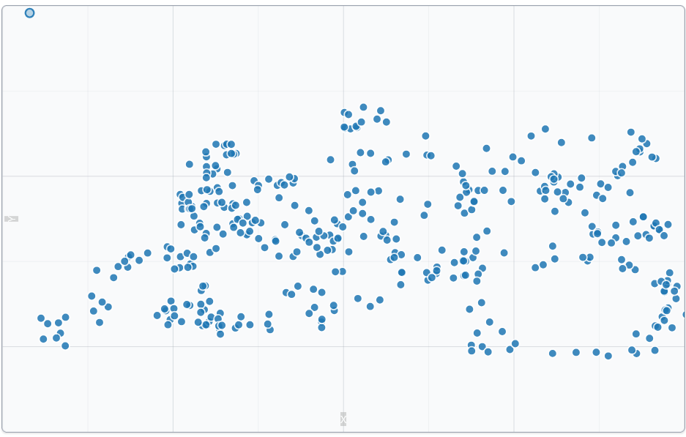
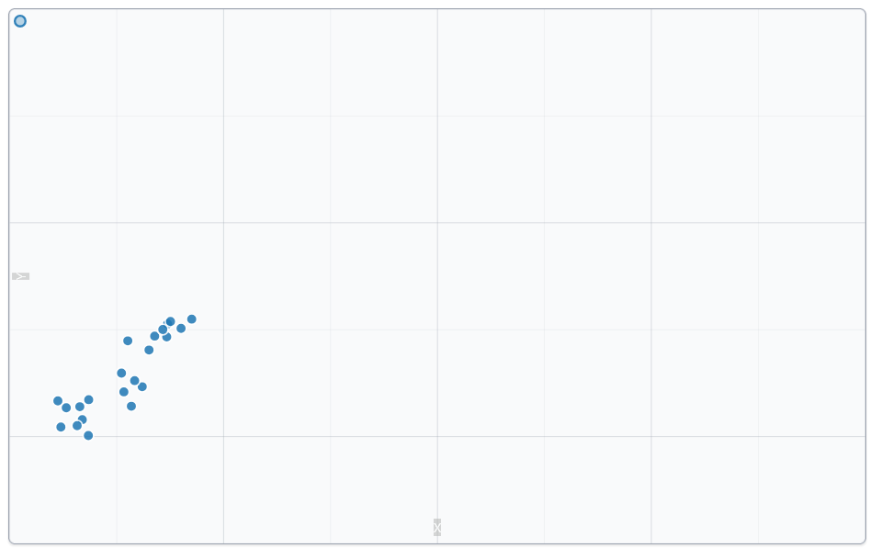
Factors that Influence Pearson r
Truncated Range: When data are collected from a restricted range of the full scale, the resulting scores may provide incomplete or misleading information about the true relationship across the entire range
Most often reduces r
But in some cases can increase r by chance

Slide 57
Factors that Influence Pearson r
Relationship is real and strong/weak
Sampling error
Unmeasured third variable
Heterogenous sample
Truncated ranges
Non-Linear Relationship
Heteroscedasticity

Slide 58
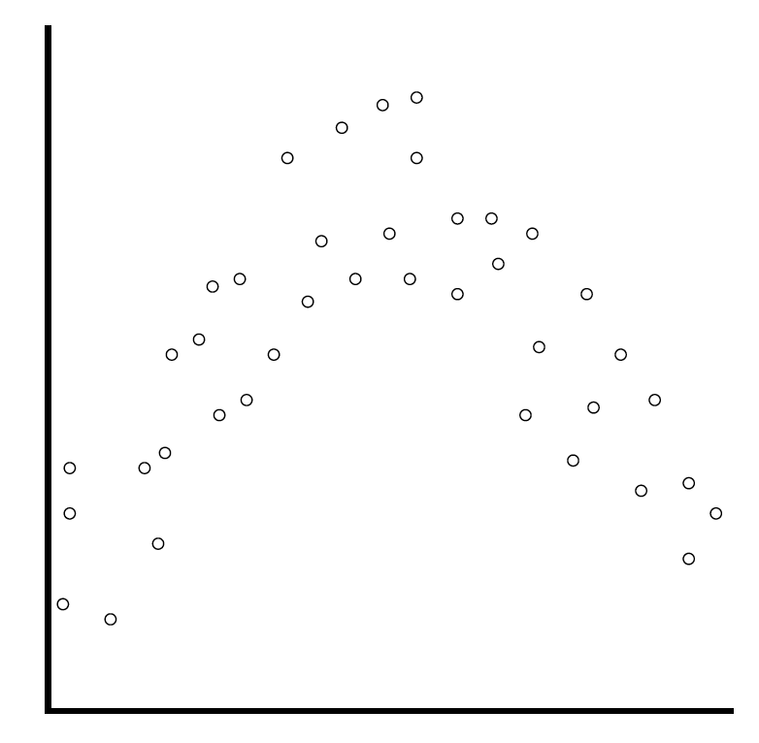
Factors that Influence Pearson r
Non-Linear Relationships: Correlations may not be linear
Treating a non-linear relationship as linear can decrease r
Treating a linear relationship as non-linear can also decrease r
There exists non-linear tests (this is part of regression)
r = .12
r = .78

Slide 59
Factors that Influence Pearson r
Relationship is real and strong/weak
Sampling error
Unmeasured third variable
Heterogenous sample
Truncated ranges
Non-Linear Relationship
Heteroscedasticity

Slide 60
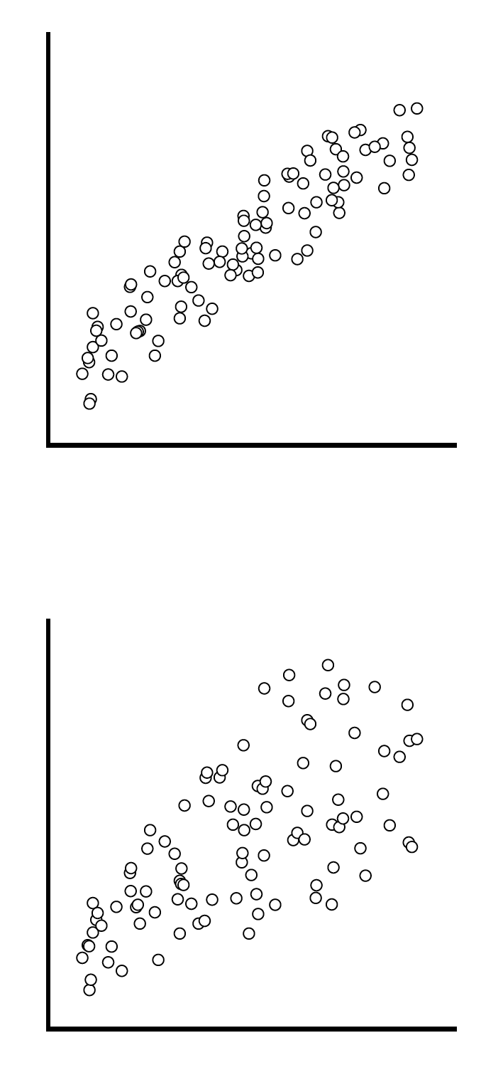
Factors that Influence Pearson r
Homoscedasticity (r = .93)
Relationship is real and strong/weak
Sampling error
Unmeasured third variable
Heterogenous sample
Truncated ranges
Non-Linear Relationship
Heteroscedasticity
Heteroscedasticity (r = .67)

Slide 61
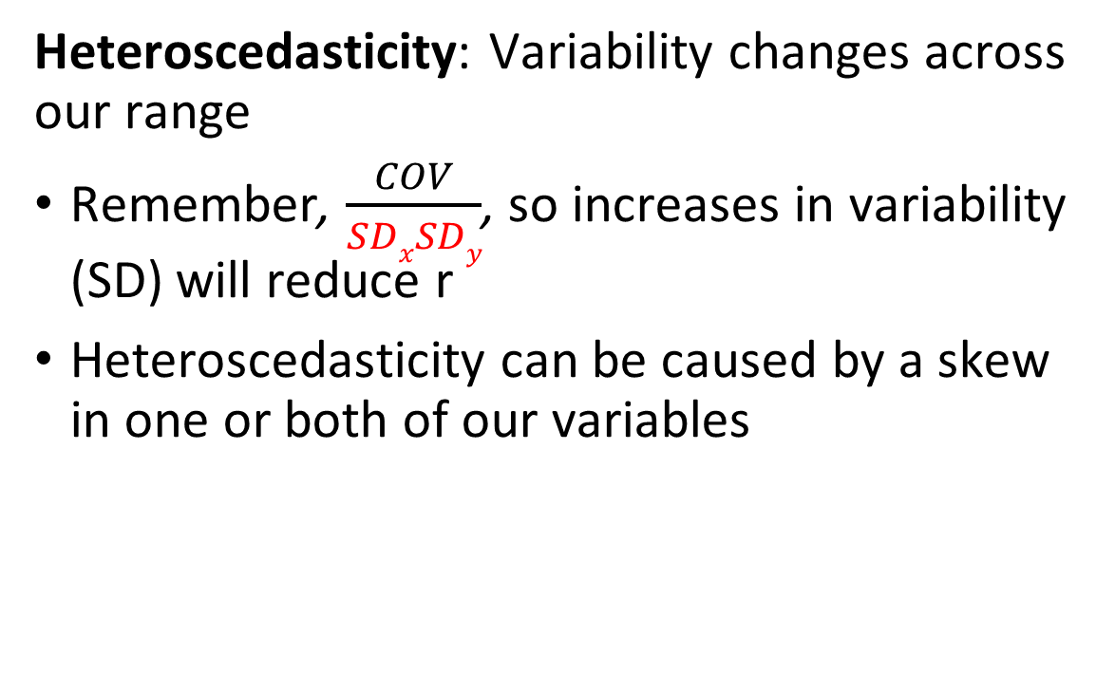
Factors that Influence Pearson r
Homoscedasticity (r = .93)
Heteroscedasticity: Variability changes across our range
Remember, $\frac{COV}{SDxSDy}$, so increases in variability (SD) will reduce r
Heteroscedasticity can be caused by a skew in one or both of our variables
Heteroscedasticity (r = .67)

Slide 62
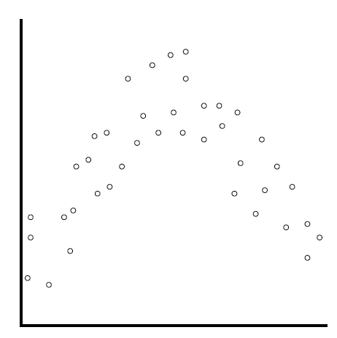
Final Note on Sample Size
Sample Size:
There is an incorrect assumption that the larger the sample size, the larger the correlation
In fact, sample size does not have any direct impact on correlations
It will, however, have an impact on whether we decide the correlation is significant (Unit 3.1. but mostly 300B)

Slide 63
Lecture Outline
Bivariate Data
Computing Correlation
Factors that Influence r
Other Scales and Correlations

Slide 64
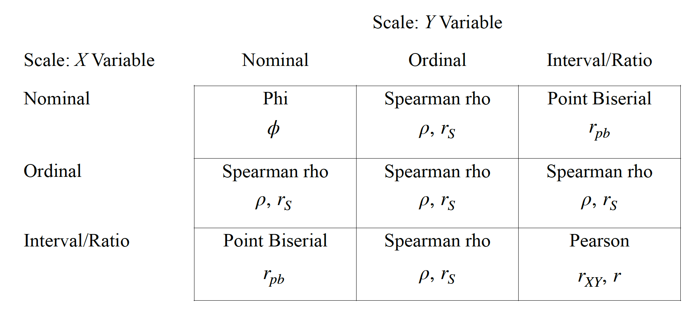
Other Scales and Correlation

Slide 65
Other Scales and Correlation
Use Pearson r
Turn scores to ranks,
Use Pearson r
Use Pearson r
Turn scores to ranks,
Use Pearson r
Turn scores to ranks,
Use Pearson r
Turn scores to ranks,
Use Pearson r
Use Pearson r
Turn scores to ranks,
Use Pearson r
Use Pearson r

Slide 66
Other Scales and Correlation

Slide 67
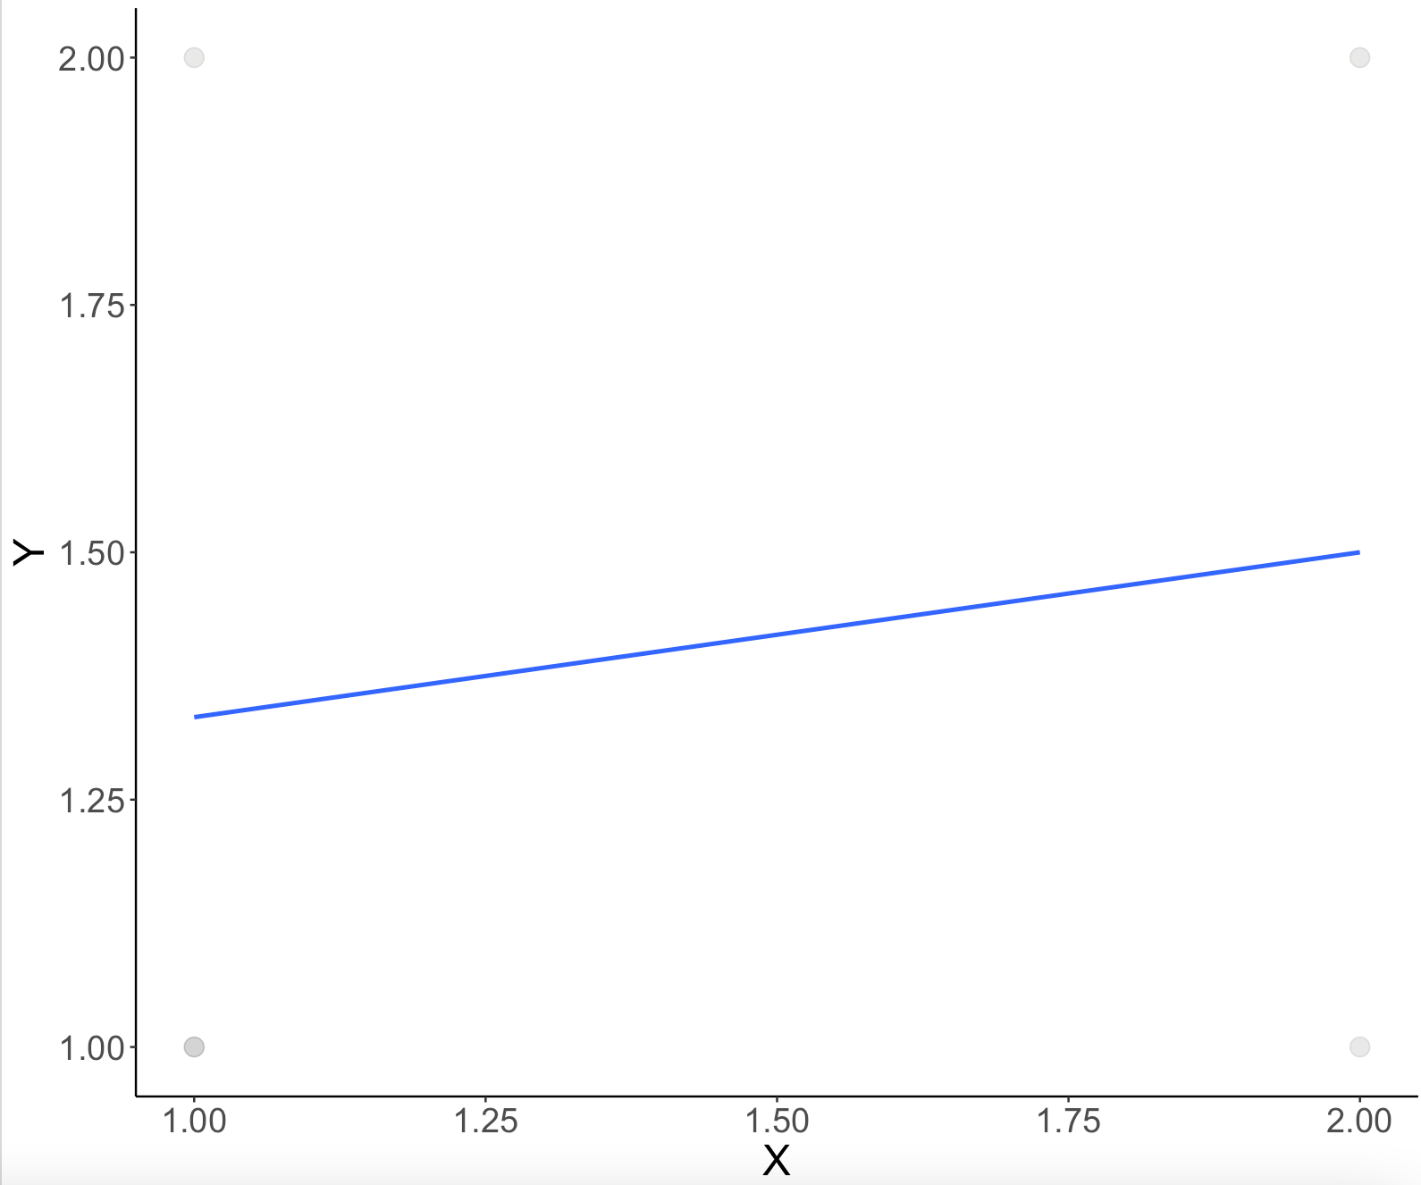
Phi(ɸ)
Scales:
Two nominal scales
Computation:
Use Pearson r
X | Y
1 | 1
1 | 2
1 | 1
2 | 2
2 | 1

Slide 68
Other Scales and Correlation

Slide 69
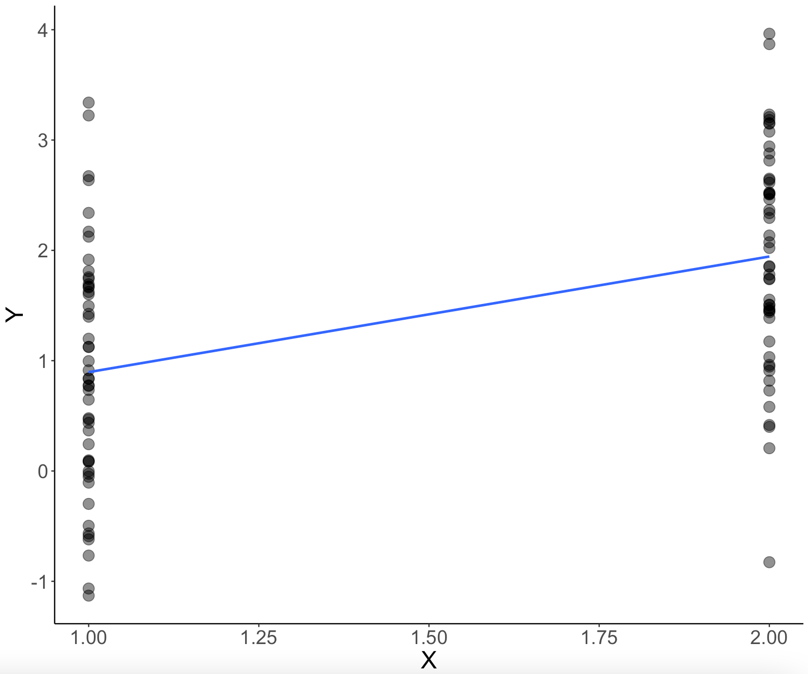
Point Biserial (r_{pb})
Scales:
X Variable = Nominal Data (only two groups)
Y Variable = Score Data (interval/ratio)
Computation:
Use Pearson r

Slide 70
Other Scales and Correlation

Slide 71
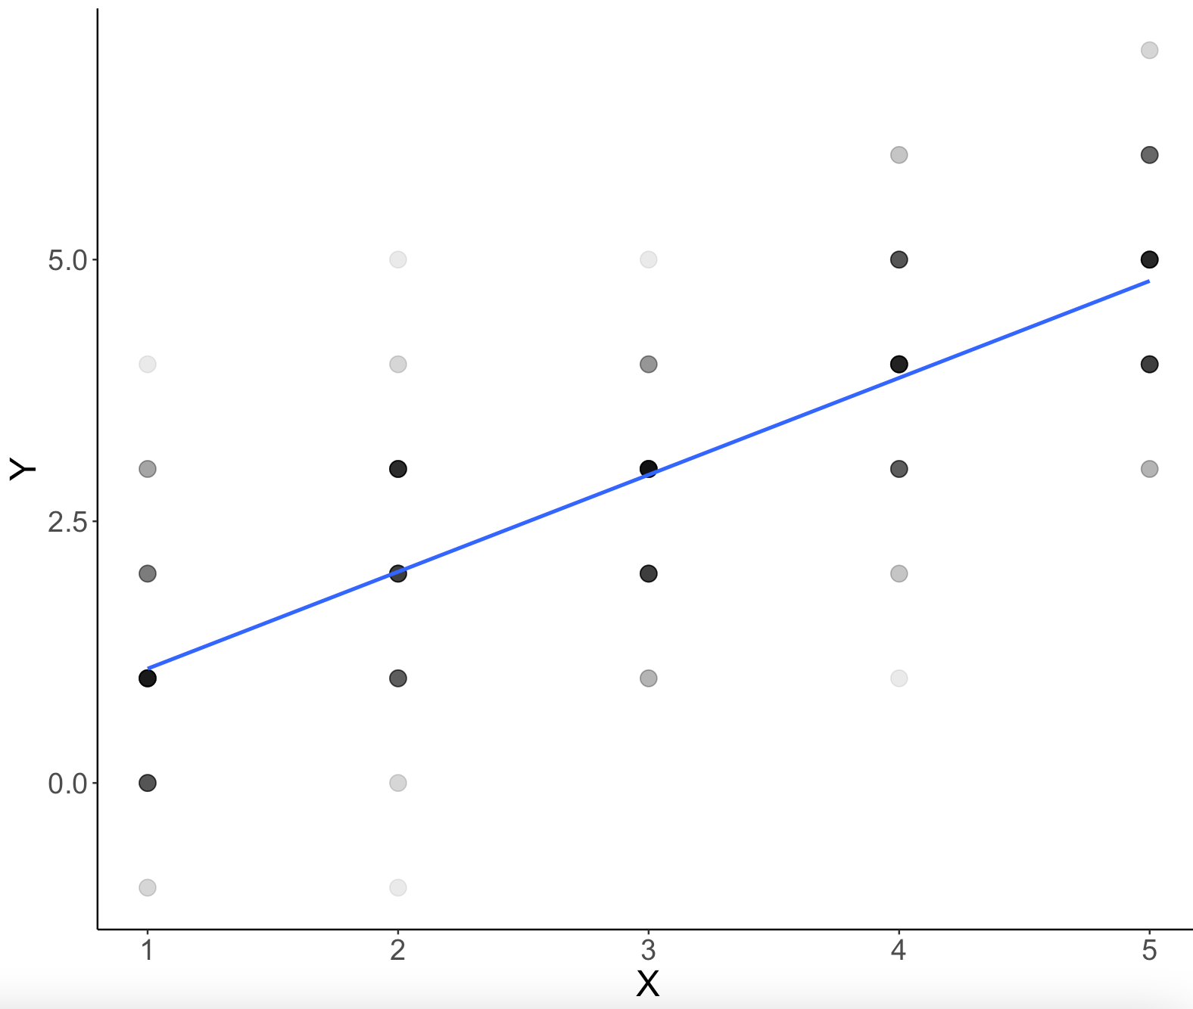
Spearman Rho (ρ or r_{s})
Scales:
Any of the scales (X or Y) are ordinal
But should also transform data into ordinal when there is heteroscedasticity or skew
Computation:
Transform your data into ranks
Use Pearson r

Slide 72
Spearman Rho (ρ or r_{s})
Computation:
Transform your data into ranks
Use Pearson r
X | X Ranked
10 | 1
14 | 3.5
31 | 6
14 | 3.5
15 | 5
12 | 2

Slide 73
Other Scales and Correlation
Use Pearson r
Turn scores to ranks,
Use Pearson r
Use Pearson r
Turn scores to ranks,
Use Pearson r
Turn scores to ranks,
Use Pearson r
Turn scores to ranks,
Use Pearson r
Use Pearson r
Turn scores to ranks,
Use Pearson r
Use Pearson r

Slide 74
Extra Resources

Slide 75
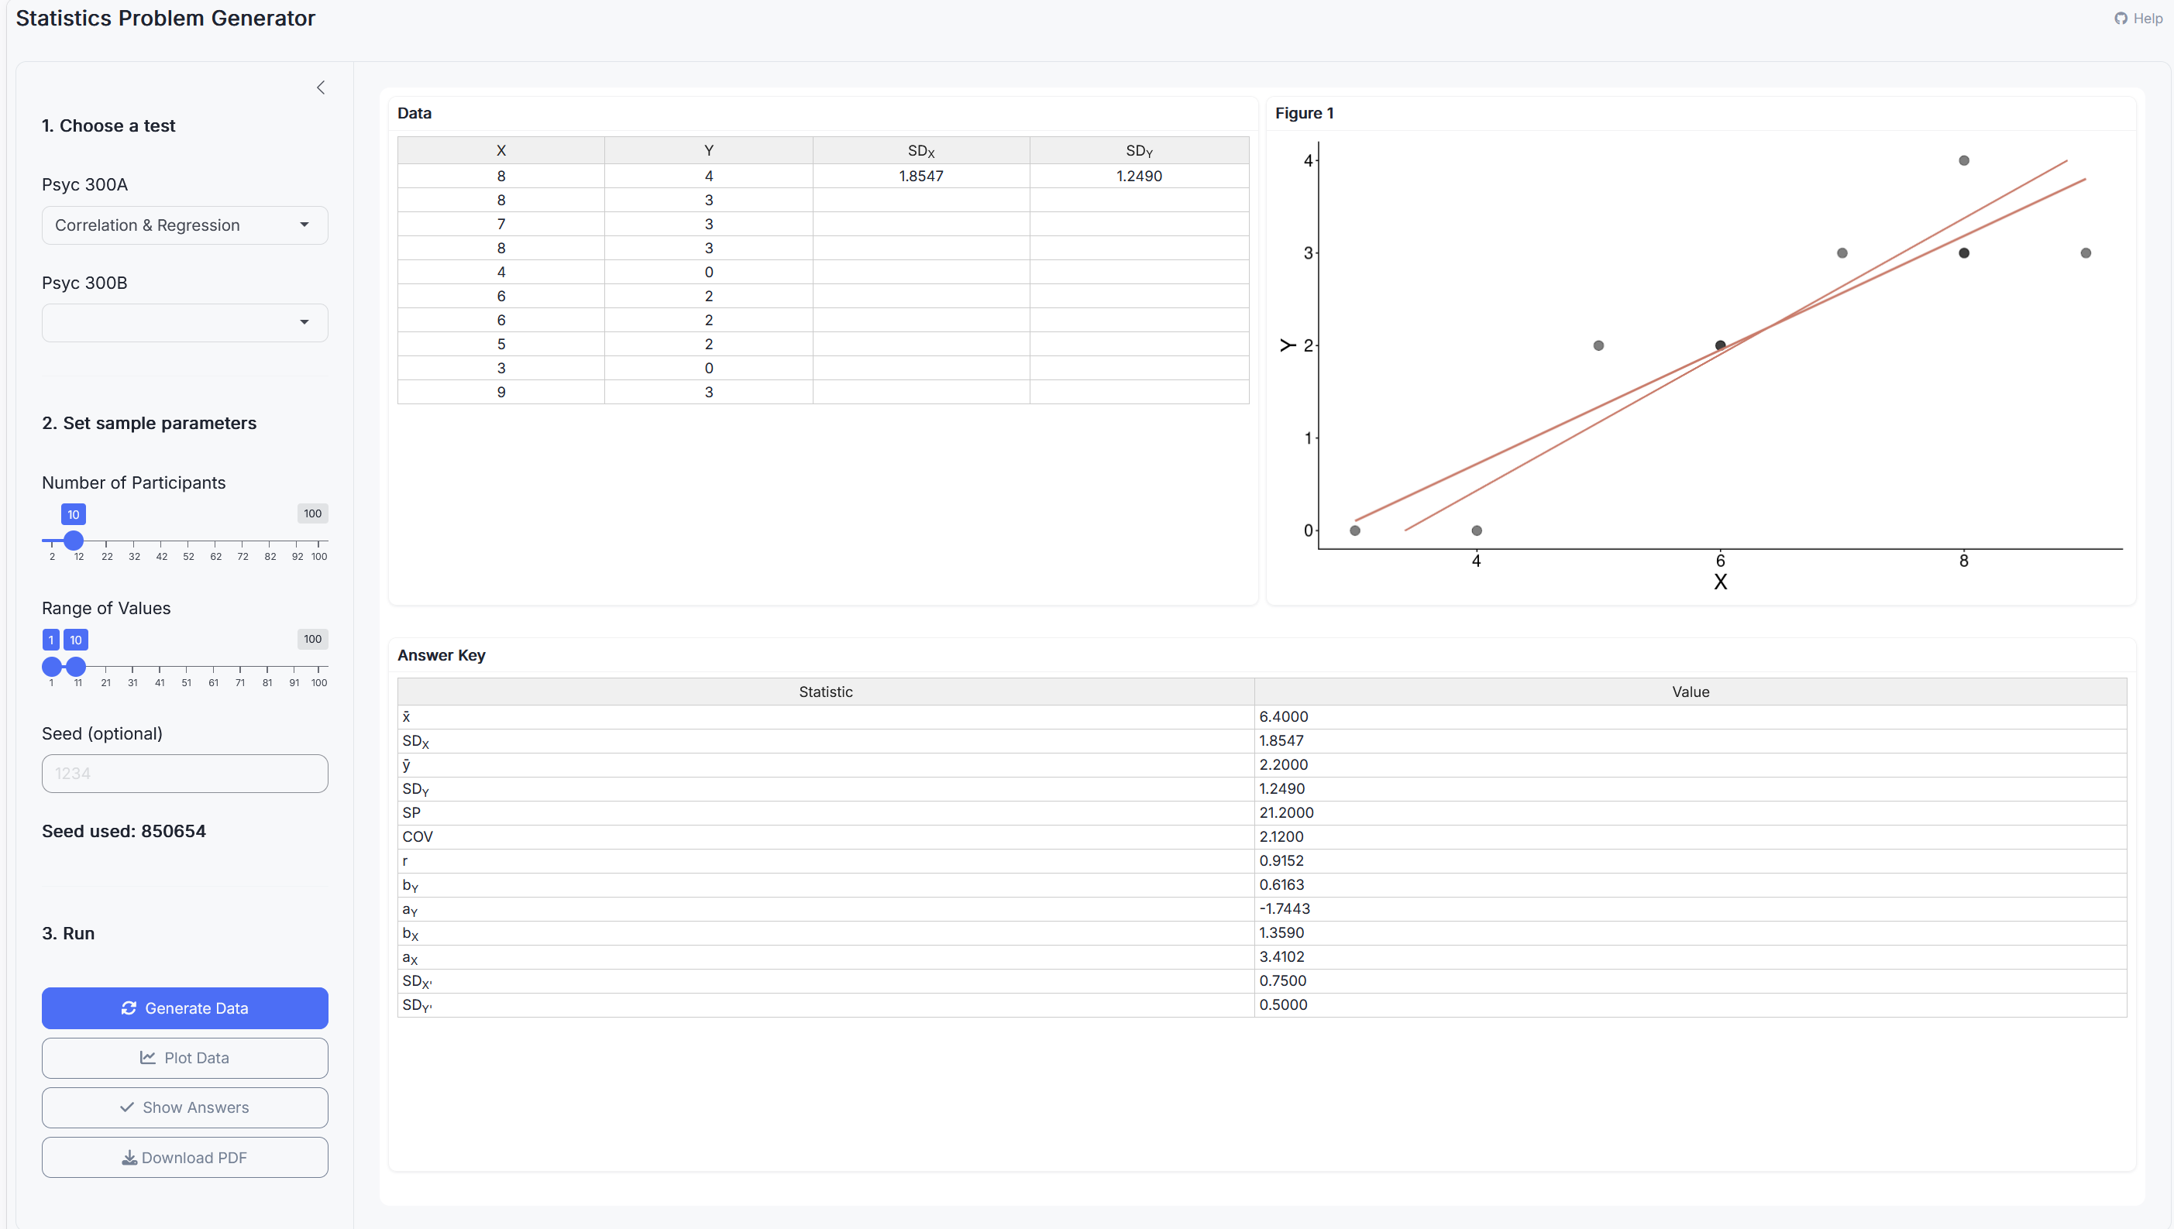
Stats Problem Generator
https://chadcwilliams.shinyapps.io/StatsProblemGenerator/

Slide 76
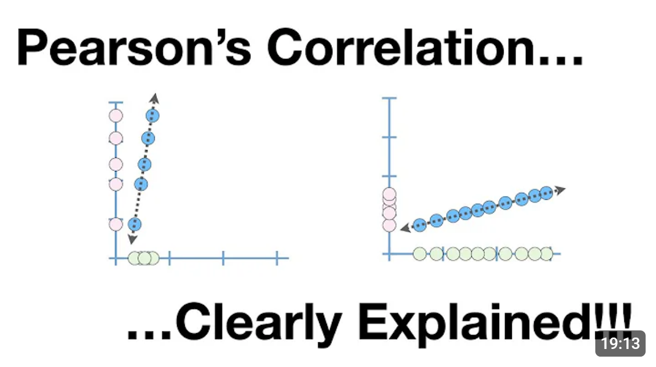
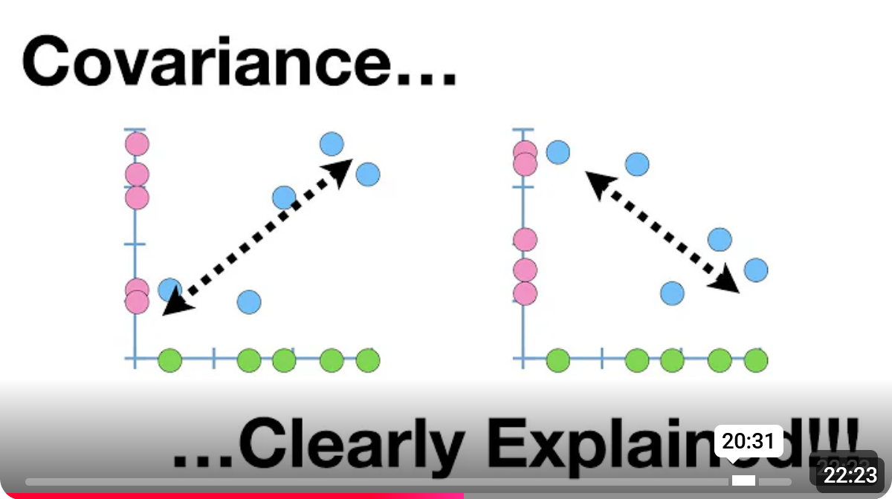
Extra Resources

